Slide 1
Questions
Briefly explain the need of a programming language?
2. Compare and contrast the differences between followings;
Source Code vs. Machine Code
High Level Language vs. Low Level Language
Compiler vs. Interpreter
Structured Language vs. Object Oriented Language
C vs. C++
C++ v. Java
Syntax error vs. Logical error

Slide 2

Why we should study Software Engineering or programming ?

Slide 3
Six IT firms in Sri Lanka were recognized amongst Sri Lanka’s Best Companies to work for by Great Place to Work® Institute.
Congratulations to Virtusa, IFS R&D International, 99X Technology, attune, ewiz and Millennium IT!
SLASSCOM is immensely proud of the IT industry’s presence in the top 20 and the exceptional contribution by these companies to uplift industry standards.

Slide 4
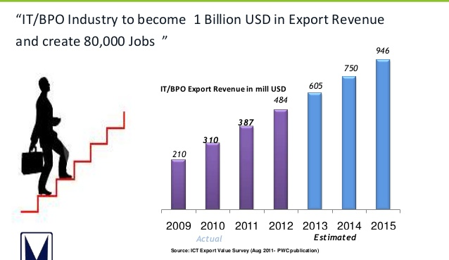
Demand for IT vs IT Job market

Slide 5
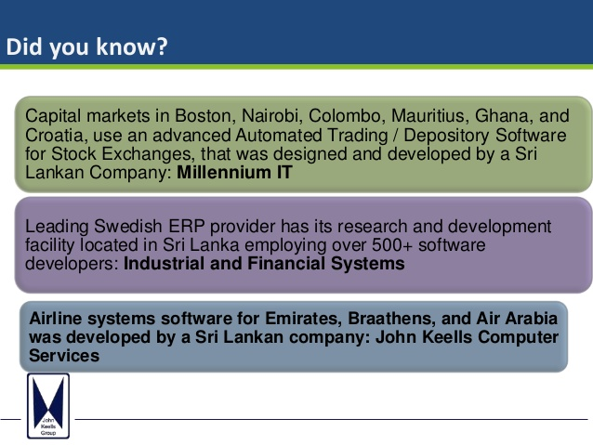

Slide 6
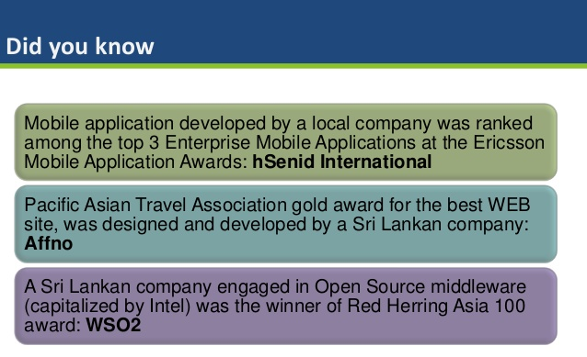

Slide 7
Some of the IT jobs available in the industry
Software Engineer / Programmer
Quality Assurance Engineer
Project Manager
Business Analyst
Software Support Engineer
Implementation Engineer
IT trainer
Database Administrator
Web Designer / Developer
IT executive
Network Administrator
Security Expert

Slide 8
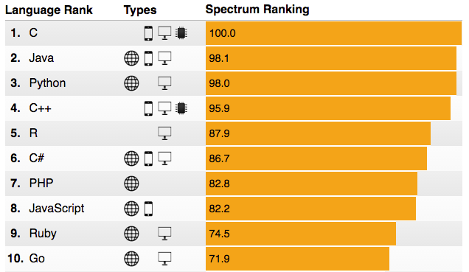
The 2016 Top Programming Languages
Ref : http://spectrum.ieee.org/computing/software/the-2016-top-programming-languages

Slide 9
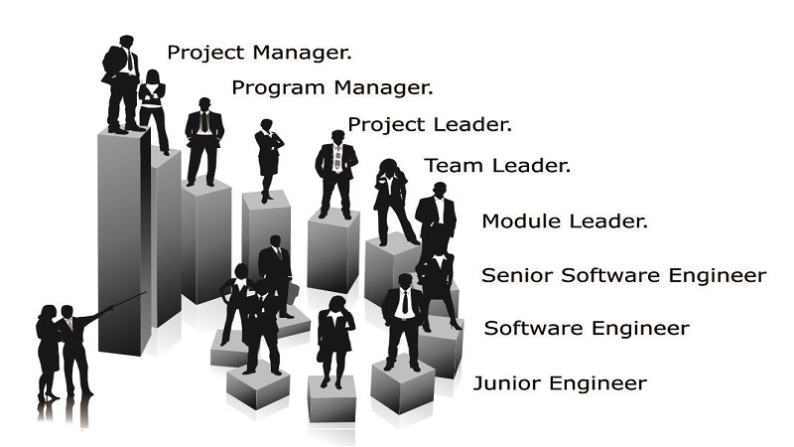

Slide 10


Slide 11
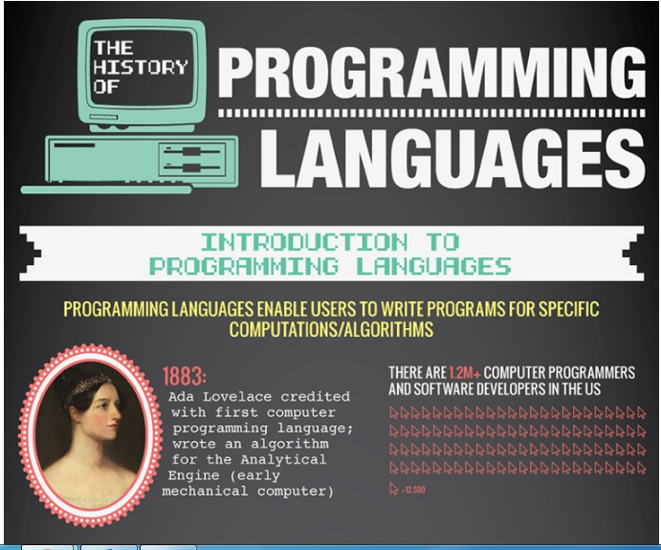

Slide 12
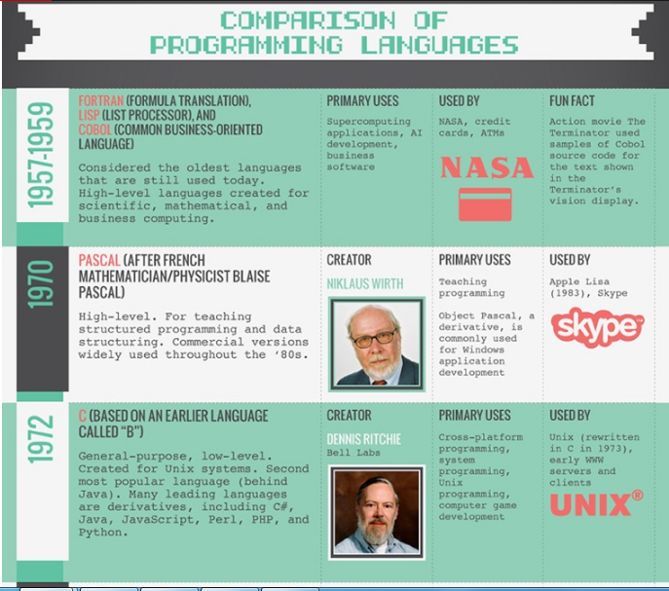

Slide 13
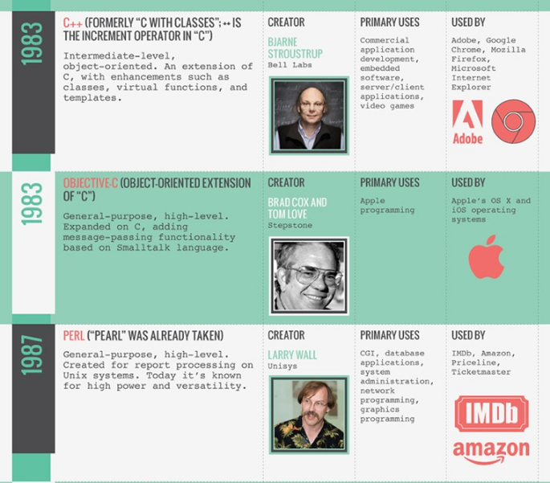

Slide 14
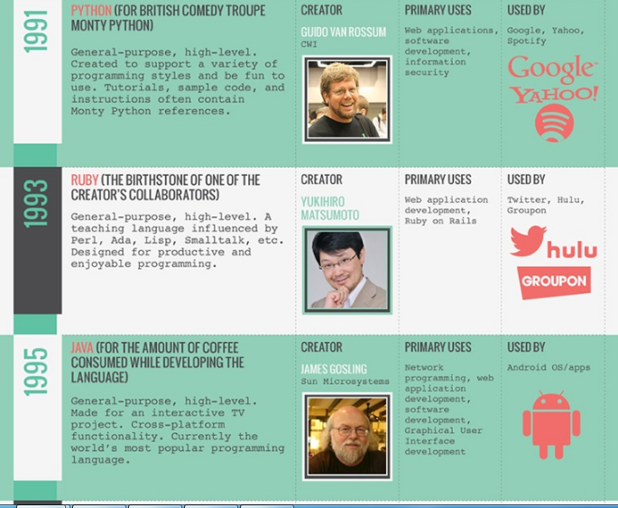

Slide 15
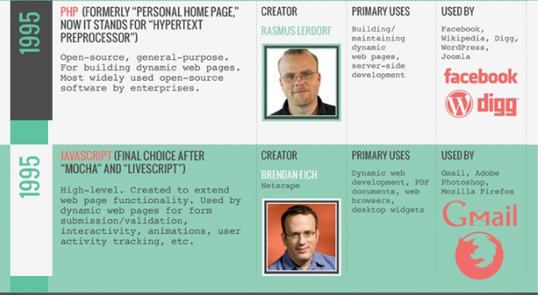

Slide 16
